Slide 1

Provider Shift Sign-Up
GOES LIVE MONDAY, OCT 12
How scheduling works for our providers, starting October 12
Virtual Town Hall · Thursday, October 8, 2026
Notes:
Welcome everyone. Tonight is about one change: starting Monday, October 12, we schedule by shifts. You pick your own shifts in the Hub, and Tier 1, 2 and 3 seats come with a $200 minimum per shift. About 20 minutes, then questions.

Slide 2
Where our patients come from, every weekday
Our busiest states and where each ranked on each weekday · January 1 to October 2, 2026
State | Mon | Tue | Wed | Thu | Fri
NV | 1 | 1 | 1 | 1 | 1
LA | 4 | 3 | 2 | 4 | 2
FL | 3 | 4 | 3 | 3 | 3
TX | 2 | 2 | 6 | 2 | 5
NY | 6 | 5 | 4 | 5 | 4
CA | 4 | 5 | 5 | 6 | 6
GA | 7 | 7 | 10 | 8 | 11
MA | 9 | 8 | 8 | 7 | 7
IN | 8 | 16 | 7 | 10 | 8
VA | 10 | 12 | 9 | 8 | 14
PA | 16 | 9 | 12 | 13 | 9
NC | 12 | 15 | 12 | 12 | 14
OH | 13 | 11 | 10 | 15 | 17
SC | 17 | 10 | 12 | 17 | 11
MO | 11 | 13 | 15 | 17 | 23
MD | 15 | 20 | 15 | 15 | 10
MI | 13 | 13 | 19 | 20 | 16
Every day
The same 6 states are the top 6
Nevada, Louisiana, Florida, Texas, New York and California, every weekday. About half of each day's visits.
8 in 10
visits come from just 16 states
The top 6 plus 10 more states make up 80 to 85% of every weekday. Those 10 are our Tier 2 states.
Predictable
Demand doesn't change much day to day
So we can staff for it with set shifts, instead of hoping monthly availability matches.
Top 6 that day
Ranked 7–16
Ranked 17 or lower
State names: Tier 1 · Tier 2 · Tier 3
Notes:
This is the analysis behind the whole plan. Each column is a weekday; each number is where that state ranked that day. The dark cells: Nevada, Louisiana, Florida, Texas, New York and California are the top 6 on every single weekday, about half of each day's visits. The next 10 states, our Tier 2 states, fill almost all of places 7 to 16, and together these 16 states are 80 to 85 percent of every day. Michigan is the busiest of the remaining states. Demand is predictable; it's our supply that hasn't matched it. Data: Athena appointments January 1 to October 2, 2026, Monday to Friday, excluding Nevada behavioral health, ancillary staff and async visits. Ties share a rank.

Slide 3
The rankings split the country into three tiers
Each tier is defined by how its states rank, day after day
Tier 1
Tier 2
Tier 3
Top 6 on every weekday
Ranked 7 to 16 on most days
Every other state
57% of our visits
25% of our visits
18% of our visits
6 states
10 states
34 states and DC
NV
LA
FL
GA
MA
IN
VA
PA
AK
AL
AR
AZ
CO
CT
DC
TX
NY
CA
NC
OH
SC
MO
MD
DE
HI
IA
ID
IL
KS
KY
ME
MI
MN
MS
MT
ND
NE
NH
NJ
NM
OK
OR
RI
SD
TN
UT
VT
WA
WI
WV
WY
Tier 2 only takes states that rank 7–16 day after day. Michigan, New Jersey and Colorado sometimes break into the top 16, but not consistently, so they stay in Tier 3.
Notes:
This is how we read the table. Tier 1 is the six states that are in the top 6 every single weekday: about 57 percent of our visits. Tier 2 is the next 10 states, which hold places 7 to 16 on most days: about a quarter of visits. Together that's 8 in 10. Tier 3 is everything else, 34 states plus DC, each small, but together about 18 percent. Each tier gets its own seat on every shift, so every state has someone licensed there on every shift. Percentages are of weekday visits with a known state, January 1 to October 2, 2026.

Slide 4




Three tiers of states means three groups of providers
Our general providers are grouped the same way, by the states they're licensed in
Tier 1 states
6 states · 57% of visits
Tier 1 providers
Licensed in our busiest states and able to give time every weekday. They hold the Tier 1 seat on every shift.
Tier 2 states
10 states · 25% of visits
Tier 2 providers
Licensed in the next 10 states. Those patients are booked with them first, which keeps Tier 1 free for the busiest states.
Tier 3 states
34 states and DC · 18% of visits
Tier 3 providers
Every other active general provider. Together they cover all the remaining states.
Each provider is in one group
You see one patient at a time, so you hold one tier. You're placed where your licenses do the most good.
Some providers have their own seats
Specialists, async-only doctors and clinic providers sign up for their own seats instead.
Notes:
If our patients fall into three tiers of states, our providers have to be organized the same way. Tier 1 providers are licensed in the busiest states and can give time every weekday. Tier 2 providers cover the next 10 states, and those patients go to them first, so Tier 1 stays free for the busiest states. Everyone else is Tier 3 and together covers the rest of the country. Each of you is in exactly one group, because you can only see one patient at a time. Specialists, async-only doctors and our clinic providers have their own seats, which we'll get to. This is why every shift has a Tier 1, Tier 2 and Tier 3 seat.

Slide 5


Two more groups of providers
Not every provider fits a general tier, so these groups get seats of their own
Specialists
Providers licensed in only one state
Why they're different
They see one kind of visit, so they don't belong in a general tier.
How they're scheduled
Patients who need that specialty are booked in the specialty seat on each shift.
Why they're different
A tier seat covers many states. With one license, most patients in that tier would have no one to see.
How they're scheduled
A routed provider seat (RP) puts them first in line for every patient from their state on that shift.
Endocrinology
1 seat per shift
Obesity Medicine
2 seats per shift
RP (NY)
New York, every shift
RP (MS)
Mississippi, Thursdays
If you do weight-loss visits, you can hold an Obesity Medicine seat on top of your regular seat.
This keeps the tier seats for providers who can cover many states.
Notes:
Two groups don't fit neatly into Tiers 1 to 3. Specialists, like our endocrinologists and our weight-loss providers, see one kind of visit, so they have their own seats: one Endocrinology seat and two Obesity Medicine seats on every shift. If you do weight-loss visits, you can hold an Obesity Medicine seat on top of your regular seat. Providers licensed in only one state can't cover a tier, so they get a routed provider seat: first in line for every patient from their state. Today that's New York every shift and Mississippi on Thursdays. Async-only doctors and our clinic providers also have their own seats, which we'll see on the seat map.

Slide 6


On-site providers: in person and telehealth
Our clinic providers see their state's patients both ways
One provider, two ways to see patients
Las Vegas clinic
Nevada is our #1 state on every weekday
NV
OS (NV)
2 seats per shift
In person
At the clinic, for patients who come in.
Telehealth
Virtual visits for any patient in their state, whenever the clinic schedule has room.
Iowa Quick Care
Louisiana is in our top 4 on every weekday
LA
OS (LA)
1 seat per shift
Why it helps everyone: Nevada and Louisiana patients go to our clinic providers first, which frees the Tier 1 seat for Florida, Texas, New York and California.
Notes:
Our clinic providers are the one group that can do both. At the Las Vegas clinic and at Iowa Quick Care in Louisiana, providers see patients in person, and when the clinic schedule has room they also see their state's telehealth patients. Nevada is our number one state every single weekday and Louisiana is always in the top 4, so we want the clinic teams seeing as close to all of those patients as possible. That's why every shift has two OS (NV) seats and one OS (LA) seat. It also helps the rest of you: with Nevada and Louisiana covered by the clinics, the Tier 1 seat can focus on Florida, Texas, New York and California. Virtual providers can't take in-person visits, but clinic providers can take telehealth.

Slide 7




Why we are changing how we schedule
The old way was hard on you and hard on our patients
We chase you every month
A JotForm for availability, then repeated emails and WhatsApp reminders.
What you get instead
Set shifts you choose yourself
$200 minimum per shift in Tier 1, 2 and 3 seats
A medical assistant starts intake 30 minutes before you
Sign up any time, up to 26 weeks ahead
No more monthly availability forms
Hours don't match demand
The hours we get often aren't in the states or days patients need.
Block time feels risky
Paid per consult, an empty block means no pay, so few of us want to give long blocks.
Volume is uneven
Some providers are swamped while others with open time see very few patients.
Notes:
Be candid: the monthly JotForm and the chasing has been painful for everyone. Per-consult pay made block time risky for you. The new system fixes the incentive: you commit to a shift, and in a tier seat you are guaranteed at least $200 for it.

Slide 8



The new system in three ideas
Everything else is detail
1 Shifts
2 Seats
3 A $200 floor
Monday to Friday, two shifts a day.
Every shift has named seats.
For Tier 1, 2 and 3 seats only.
Morning 9:00 am – 12:00 pm
Afternoon 1:00 pm – 5:00 pm
Eastern Time
You sign up for a seat on a shift by picking your own name from that seat's list.
Your per-consult pay or $200 for the shift, whichever is higher.
Notes:
If people remember only one slide, make it this one. Shifts, seats, and a $200 floor for the three tier seats.

Slide 9

What a shift looks like
All times are Eastern. A medical assistant starts intake 30 minutes before you.
8:30 am
9:00 am
12:00 pm
12:30 pm
1:00 pm
5:00 pm
MA starts intake
Morning shift starts
Morning shift ends
MA starts intake
Afternoon shift starts
Afternoon shift ends
Outside the Eastern time zone?
The morning shift starts at 9:00 am Eastern = 8:00 am Central = 7:00 am Mountain = 6:00 am Pacific. The afternoon shift starts at 1:00 pm Eastern = 10:00 am Pacific.
Notes:
The MA starts intake 30 minutes early so your first patient is ready when you log on. West coast providers: the afternoon shift, 10 am to 2 pm Pacific, is often the easier fit.

Slide 10

Every shift, at a glance
Each group of providers has its own seat on every shift
Tier seats
Specialty and async
On site (OS)
Routed (RP)
Tier 1
Tier 1 providers
Endocrinology
Endocrinologists
OS (NV) ×2
Las Vegas clinic
RP (NY)
Every shift
Tier 2
Tier 2 providers
Obesity Medicine ×2
Weight-loss providers
OS (LA)
Iowa Quick Care
RP (MS)
Thursdays
Tier 3
Tier 3 providers
Async
Async-only doctors
Filled every shift · $200 minimum
Optional · per consult only
In person and telehealth
First in line for one state
Which seat is yours? Your name appears only in the seats you can hold, and the sign-up page lists them at the top (“your seats: Tier 2”). If it looks wrong, tell the scheduling team.
Notes:
This puts the last few slides together. Every shift has a seat for each group: the three tier seats, which must be filled every shift and carry the $200 minimum; the specialty and async seats; the clinic seats; and the routed seats. Tiers are about states, not seniority or quality. Your name appears only in the seats you can hold, and the sign-up page shows your seat at the top.

Slide 11

The $200 minimum, Tier 1, 2 and 3 only
Per-consult pay stays the same. The minimum is a floor under a slow shift.
$200
A typical shift
A slow shift
8 consults × $40 = $320
3 consults × $40 = $120
You are paid $320
You are paid $200
guaranteed per shift when you hold a Tier 1, Tier 2 or Tier 3 seat
Example at $40 per consult. Your own per-consult rate applies.
You are paid your per-consult earnings or $200, whichever is higher.
Every other seat is per consult only, with no minimum: Endocrinology, Obesity Medicine, Async, on-site (OS) and routed (RP).
Notes:
Be precise here: the $200 minimum applies only to Tier 1, Tier 2 and Tier 3 seats. Nothing changes about per-consult pay. On a normal shift you will earn more than $200; the minimum only matters on an unusually slow shift. No other seat carries the minimum.

Slide 12
How to sign up, in five steps
It takes about two minutes the first time
1
2
3
4
5
Go to the Hub
In your browser, open
hr.myvirtualphysician.com
Sign in with your NPI
Choose “Provider Login (NPI)” and enter your NPI number.
Open Provider Shift Sign-Up
It opens on the week of October 12.
Set “Repeat my sign-up for”
Just that date, or 2, 4, 8 or 13 weeks. Set this first.
Pick your name in your seat
Click “Choose your name…” on the shift you want.
The top of the page, as you'll see it:
“Repeat my sign-up for 4 weeks” books the same shift and seat for the next four weeks in one click.
Notes:
Walk through it live if you can. The one thing people miss: set the Repeat box before you pick your name. Picking your name with Repeat set to 4 weeks books that same shift for four weeks in one go.

Slide 13
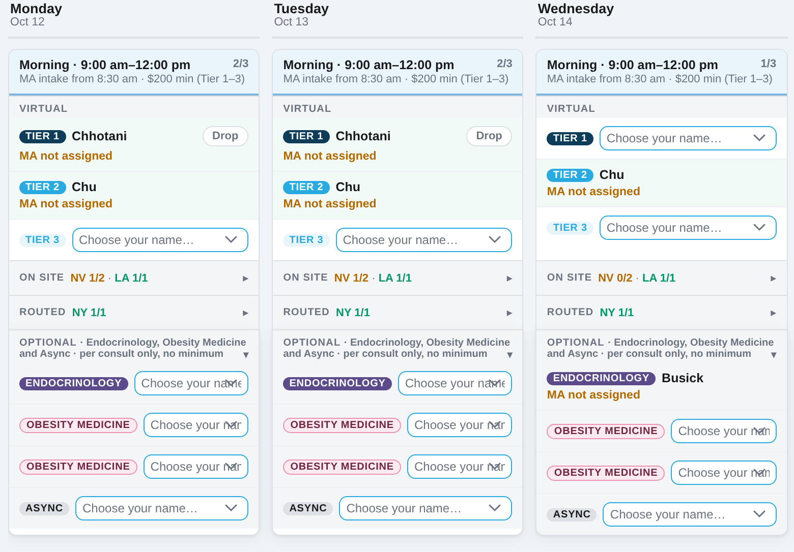
What the week looks like
A real view of Monday to Wednesday, October 12–14, as a Tier 1 provider sees it
Your name + Drop
Your booked shifts. Drop releases the seat if your plans change.
Choose your name…
An open seat. Your name is the only one you can pick.
On site / Routed
Collapsed rows for clinic and routed seats. Click to open.
Optional
Endocrinology, Obesity Medicine and Async. Per consult only.
The afternoon shifts sit below a bold line under the morning shifts.
Notes:
This is the real page. Mornings on top, afternoons below the bold line. Booked seats show the provider's last name; open seats show Choose your name. Orange text means a seat still needs an MA, which our team handles, not you.

Slide 14






Rules of the road
A few habits that keep every shift covered
Sign up early and far ahead
You can book up to 26 weeks out. Repeat for 4, 8 or 13 weeks covers a regular schedule in one step.
Plans change? Drop the seat yourself
Use Drop on your shift as soon as you know, so someone else can take it. The earlier, the better.
Time off: tell the scheduling team
They mark you unavailable, and your name is grayed out on those dates.
Working from outside the US?
If this applies to you, the scheduling team enters your US dates. You can sign up only on those dates.
Tier seats come first
Tier 1, 2 and 3 must be filled every shift. The page shows which shifts still need someone.
Seat looks wrong?
If you don't see your name where you expect it, tell the scheduling team. Seats follow your licenses.
Notes:
Most important ask: if your plans change, drop the seat in the app right away. An empty seat we know about can be filled; a no-show can't.

Slide 15






How our schedulers route special visits
These go to specific providers, whatever the shift
Window tint
Surrogacy
Veteran disability
Dr. Muehrcke and Dr. Gerber. Georgia patients: Dr. Howard.
Only Dr. Howard, Dr. Mandigo and Dr. Frarey.
The initial visit is always booked with a doctor (MD or DO), never an NP.
Weight loss
Endocrinology
Nevada and Louisiana
Booked in the Obesity Medicine seats.
Booked in the Endocrinology seat.
Seen by our Las Vegas clinic and Iowa Quick Care providers first, in person or virtually.
Notes:
So you understand why some visits don't land on your shift: these visit types are routed to specific providers. The schedulers see these reminders on the sign-up page.

Slide 16
What we need from you
Starting tonight
Tonight
This week
Mon, Oct 12
Ongoing
Sign in
Go to hr.myvirtualphysician.com, choose Provider Login (NPI), and open Provider Shift Sign-Up. Check your seat at the top.
Claim your shifts
Book your shifts from October 12 on. Use Repeat for 4 to 13 weeks to cover your regular schedule.
First shifts go live
Log on at your shift start. Your MA starts intake 30 minutes before.
Keep it current
Add shifts any time. Drop a seat right away if plans change. Tell the scheduling team about time off.
Notes:
The ask is simple: sign in tonight, check your seat, and book your shifts from October 12 on. Using Repeat is the fastest way to lock in your regular schedule.

Slide 17
Questions?
Sign up at hr.myvirtualphysician.com · Provider Login (NPI)
Help with your login or seat: info@myvirtualphysician.com
Notes:
Open the floor. Common questions: Can I hold two seats? Only an Obesity Medicine seat on top of your regular one. What if I'm late or sick? Drop the seat in the app and tell the scheduling team. Does the $200 apply to async or clinic seats? No, Tier 1 to 3 only.

